Slide 1
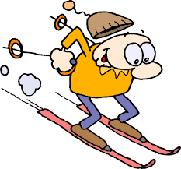
Getting Fit To Ski!!
By Michael Nagorny

Slide 2
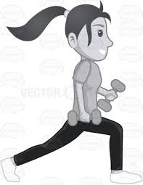
Four Exercises To Build Leg (quadriceps) Muscle and Strength
Ball Squat
Walking Lunge
Dumbbell Squat
Barbell Squat

Slide 3
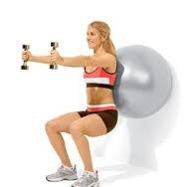
Ball Squat
Exercise Ball or any ball with some flex
Starting from a parallel knee position drop hips down while simultaneously allowing ball to guide you down
Start with no weight or little weight
Dumbbell or plate, or any sort of item that is comfortable to hold will work
Repeat 8 to 15 repetitions

Slide 4
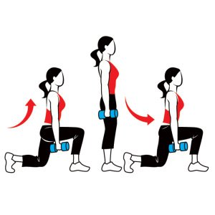
Walking Lunge
Use little or no weight in beginning
Start from a standing position
Lunge forward with one leg to where that leg goes parallel to the ground
Opposite knee should graze the floor
Return to standing position and do the same with the other leg rotating both legs
Repeat 8 to 15 repetitions

Slide 5
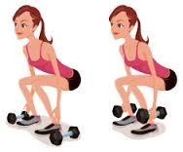
Dumbbell Squat
Use light dumbbells to begin
From a standing position bring hips down to a level where your legs are parallel to the floor
Think about sitting in a chair emphasize sticking rear end back
Return to a standing position
Repeat 8 to 15 repetitions

Slide 6
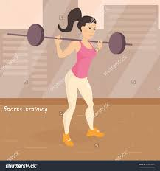
Barbell Squat
Very similar to the ball squat and dumbbell squat
Weight is distributed on a bar
Position the bar comfortably on base of neck, use a towel or other cover to protect if needed
From standing position drop hips down to a parallel position and return to standing position
Challenge will be in balancing the bar which in turn will benefit quadriceps

Slide 7
Notes:
Make sure to keep the knees from going over the plane with your toes
Concentrate on keeping the weight on your heels
Perform 3 to 5 sets 2X a week
Soreness is good ☺, pain bad ☹
Protein to aid muscles
Don’t‘ forget your other muscles, too!!!

Slide 8
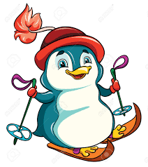
Have a Great Ski Season ☺

